Slide 1
2011 Introduction to
Deep-Draft Navigation
Economics of Deep Draft Navigation Analysis
Notes:
Instructor
Purpose of Instruction
Objective
Outline of Topic Agenda

Slide 2
Purpose
  To provide an overview of the maritime system as well as the requirements and procedures for conducting deep-draft navigation economic analyses in accordance with standards and guidance as applied by the U.S. Army Corps of Engineers (USACE).

Slide 3
Student Learning Objectives:
  Become familiar with the Maritime Transportation System and Terminology
  Identify the General Concepts and Procedural Steps for Economic Analysis Applied to the Study of Deep-Draft Waterway Improvements Under National Economic Development (NED) Criteria.
  Identify primary sources of guidance and data and exposure to some of the general terminology applied for studies.

Slide 4
“The role of the U. S. Army Corps of Engineers with respect to navigation is to provide safe, reliable, and efficient waterborne transportation systems (channels, harbors, and waterways) for movement of commerce, national security needs, and recreation. The Corps accomplishes this mission through a combination of capital improvements and the operation and maintenance of existing projects.”
-ER 1105-2-100

Slide 5
Federal Involvement – Why?
The Federal Interest is established by the Constitution –Commerce Clause
Provides means of commercial transportation
Is part of national defense
Notes:
The merits of Civil Works projects for improvement of navigation are currently measured against a single Federal objective--national economic development.

Slide 6
Corps Involvement –
So How Did the Corps Get Involved?
Gallatin’s 1808 report to Congress on waterways, canals and roads
Congressionally directed in 1824 to remove snags from Ohio & Mississippi Rivers
Notes:
The Corps mission is considered to have begun in 1824 when funds were appropriated to clear snags from Ohio and Mississippi Rivers. The Corps participates financially in general navigation features and special navigation programs only; all other features and facilities (e.g., piers) are non-Federal responsibilities.

Slide 7
U.S. Ports: Vital to Trade
…and to Our National Economy
Anacortes
Seattle
Tacoma
Kalama
53 harbors – coastal, inland, Great Lakes - handled over 10 million tons each in 2008…
Two Harbors
Portland
Duluth/Superior
Portland
Boston
Detroit
Inland Waterway System:
Chicago
Pittsburgh
Nearly 12,000 Miles 9 ft & Over
Toledo
New York/NJ
Richmond
Indiana Hbr
Cleveland
Lower Delaware
River (9 harbors)
Oakland
192 Lock Sites / 238 Chambers
Cincinnati
Baltimore
Moving Nearly 600 Million Tons
Huntington
Hampton Roads
Los Angeles
St. Louis
About 2/3rds Cost of Rail and
1/10 Cost of Truck
Memphis
Long Beach
Million
Tons
Charleston
Over 100
Baton Rouge
Savannah
Lake Charles
Pascagoula
Jacksonville
50 - 100
Houston
Barbers Pt
Texas City
Mobile
Tampa
25 - 50
Honolulu
Freeport
Port Arthur
Plaquemines
Matagorda
Beaumont
New Orleans
10 - 25
Valdez
Corpus Christi
S. Louisiana
Port Everglades

Slide 8
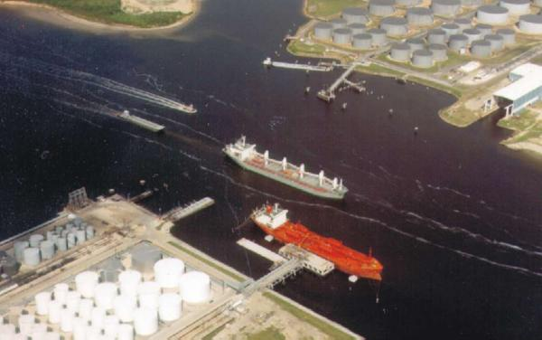
Principal US Harbor Improvements
Funded in 2009*
* Includes 2-year ARRA funding.

Slide 9
Deep-Draft Navigation System: System of independent channels that serve individual ports. For Corps purposes, these channels are in excess of 14-feet deep, and are found in coastal waters, bays, major rivers and the Great Lakes.
Deep-Draft Commercial Vessels: Ships and ocean-going tows.
Harbors: “Water Area” partially enclosed to provide safe and suitable accommodation for vessels.
Port: A sheltered harbor where marine terminal facilities are provided.
Terminal Facilities: Part of a port or harbor which provides docking, cargo-handling, and storage facilities

Slide 10
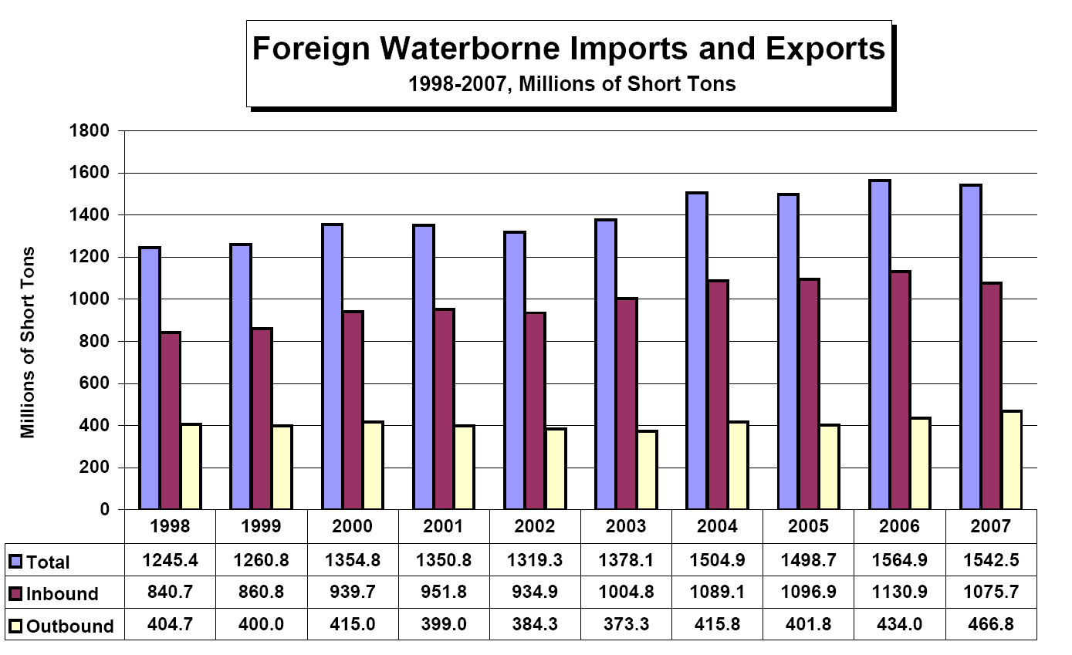

Slide 11
Top 10 Coastal U.S. Ports, 2008
(Millions of Short Tons)
Rank | Port | Tonnage
1 | Port of South Louisiana | 223.9
2 | Houston, TX | 212.2
3 | New York, NY & NJ | 153.4
4 | Long Beach, CA | 80.2
5 | Corpus Christi, TX | 76.7
6 | New Orleans, LA | 73.0
7 | Beaumont, TX | 69.4
8 | Mobile, AL | 67.6
9 | Port of Plaquemines, LA | 63.7
10 | Los Angeles, CA | 59.7
Source: USACE Navigation Data Center

Slide 12
Top 10 U.S. Ports Handling
Foreign Waterborne Commerce, 2008
(Millions of Short Tons)
Rank | Port | Tonnage
1 | Houston, TX | 146.3
2 | Port of South Louisiana | 111.4
3 | New York, NY & NJ | 91.1
4 | Long Beach, CA | 67.2
5 | Corpus Christi, TX | 55.3
6 | Los Angeles, CA | 52.9
7 | Beaumont, TX | 46.7
8 | Texas City, TX | 38.7
9 | Norfolk, VA | 36.8
10 | New Orleans, LA | 36.4
Source: USACE Navigation Data Center

Slide 13
U.S. Waterborne Traffic by State, 2008
(Millions of Short Tons)
Rank | State | Tonnage
1 | Louisiana | 484.9
2 | Texas | 442.3
3 | California | 190.1
4 | Florida | 122.5
5 | Illinois | 120.3
6 | Ohio | 119.4
7 | Pennsylvania | 115.3
8 | New Jersey | 110.1
9 | Washington | 100.9
10 | Kentucky | 100.1

Slide 15
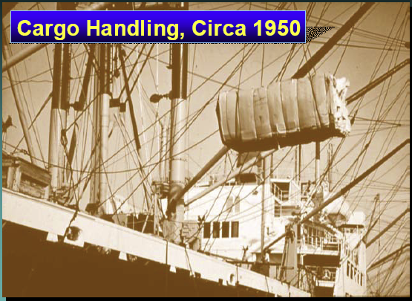
Cargo Handling, Circa 1950

Slide 16
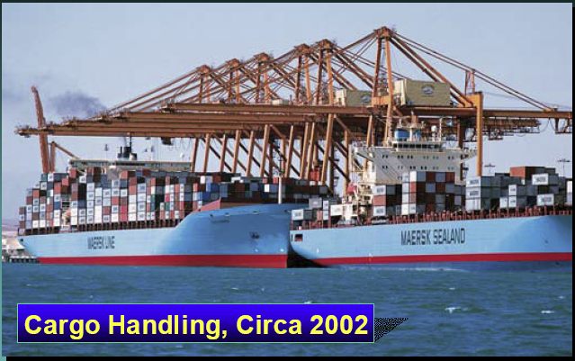
Cargo Handling, Circa 2004

Slide 17
The Need for Deeper Channels

Slide 18
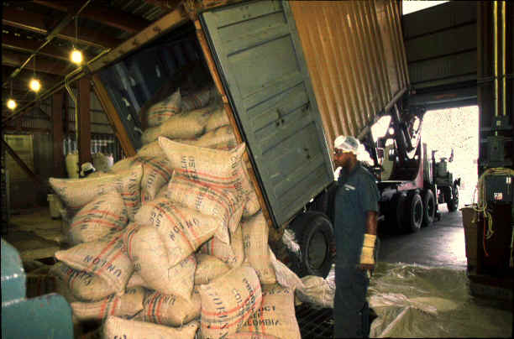
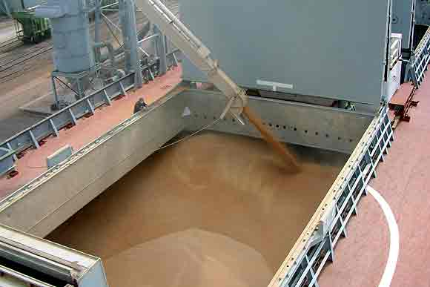
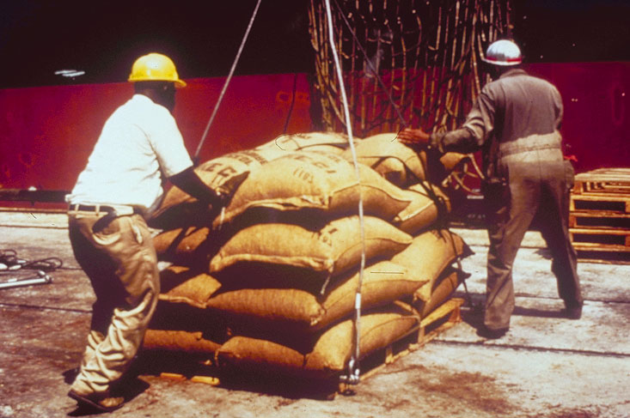
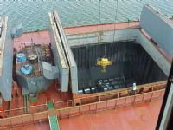
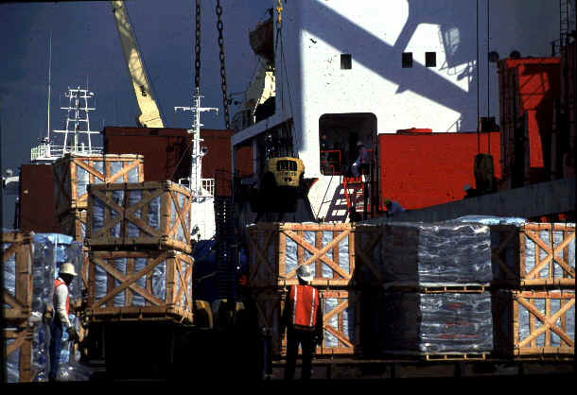
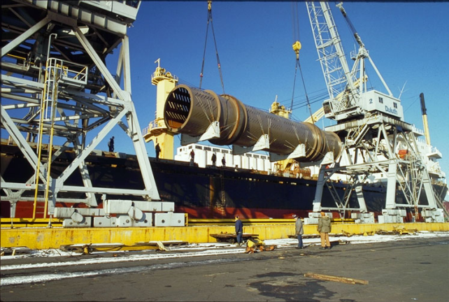
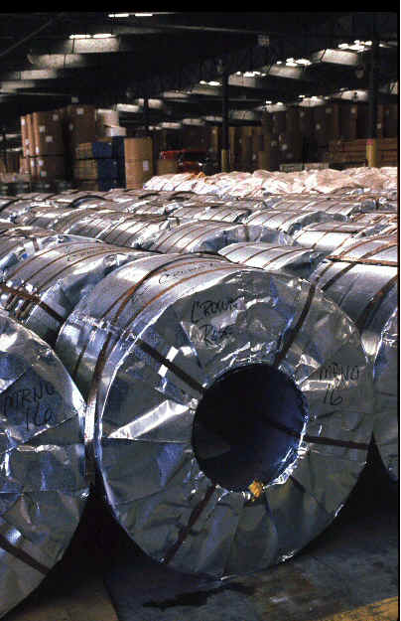
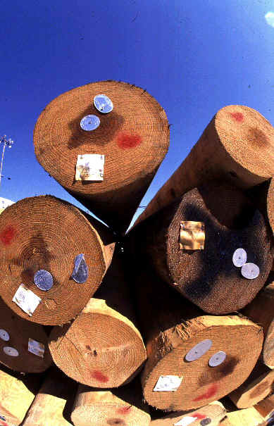
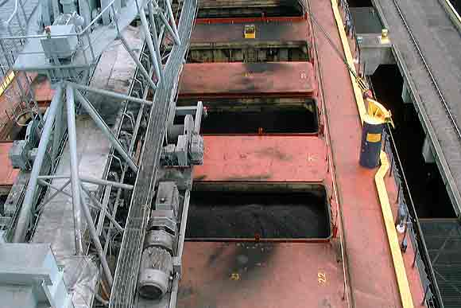
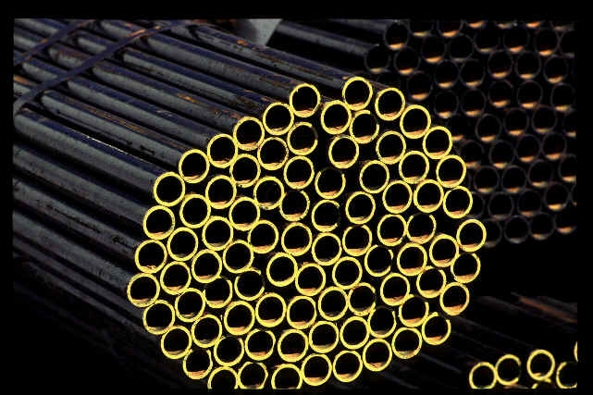
Cargo

Slide 19
Functional Classifications of Maritime Cargoes
All Maritime Cargo
General Cargo
Bulk Cargo
Break Bulk
Neo-Bulk
Containerized
Liquid Bulk
Dry Bulk
Sacks Cartons Crates Drums Pallets Bags
Lumber Paper Steel Autos
Containers
Lift On/Lift Off (Lo/Lo)
Roll On/Roll Off (Ro/Ro)
LNG / LPG Petroleum Molasses Chemicals Vegetable Oil
Grain Sand & Gravel Scrap Metal Coal/Coke Clinker Fertilizer

Slide 20
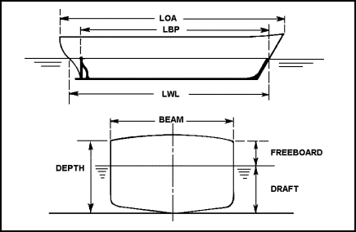
Shipboard Measurements

Slide 21
Foreign Flag General Cargo Characteristics
DWT | 11,000 | 14,000 | 16,000 | 20,000 | 24,000 | 30,000
Length | 442 | 478 | 498 | 535 | 568 | 610
Beam | 65 | 69 | 72 | 77 | 81 | 86
Draft | 26 | 29 | 30 | 33 | 35 | 38
Hourly Cost at Sea | 453 | 516 | 564 | 664 | 760 | 900
Hourly Cost in Port | 367 | 413 | 448 | 523 | 595 | 701
Note: All measurements in feet; Cost in US $
Source: USACE Economic Guidance Memo 00-06, 01 June 2004

Slide 22
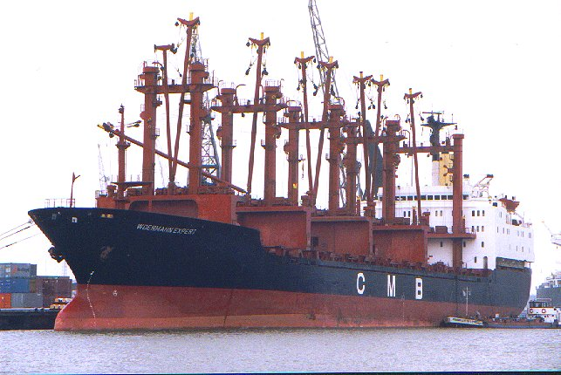
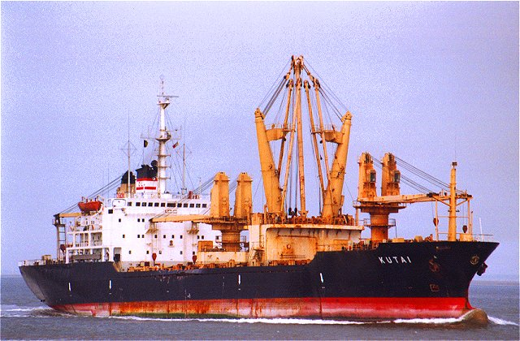
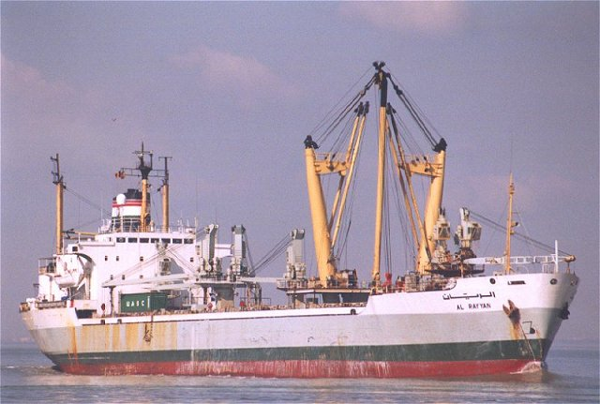
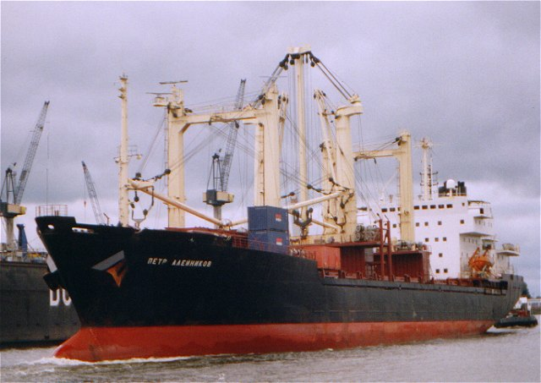
General Cargo

Slide 23
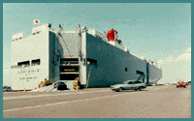
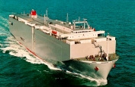
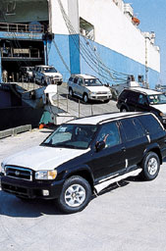
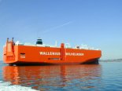
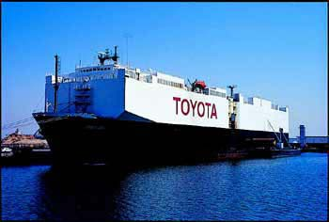
Pure Car Truck Carrier (PCTC)

Slide 24
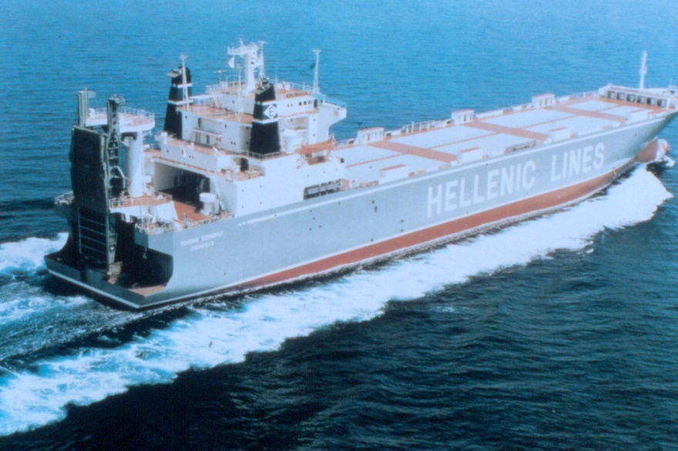
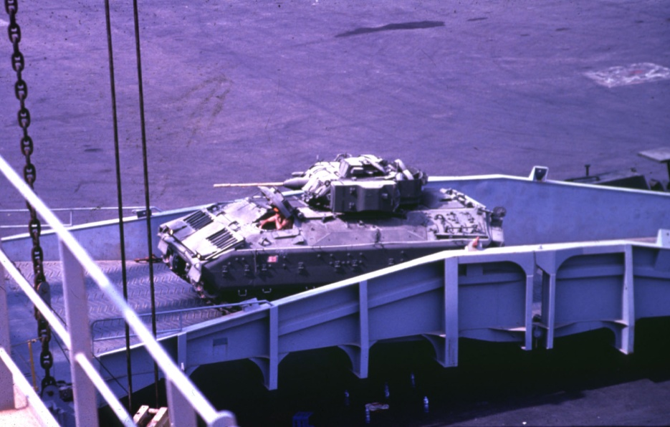
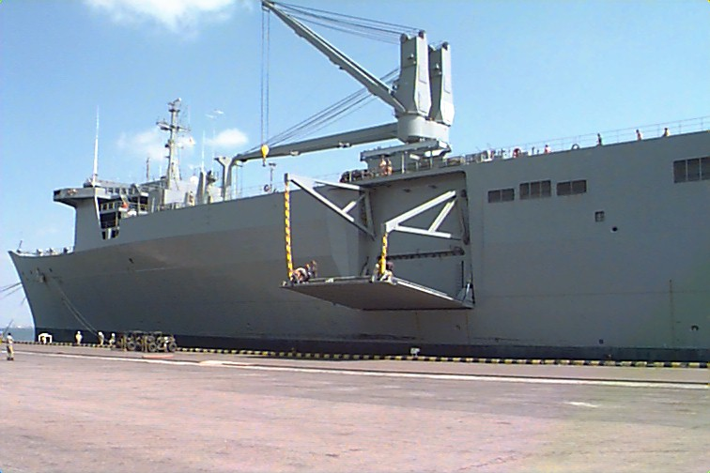
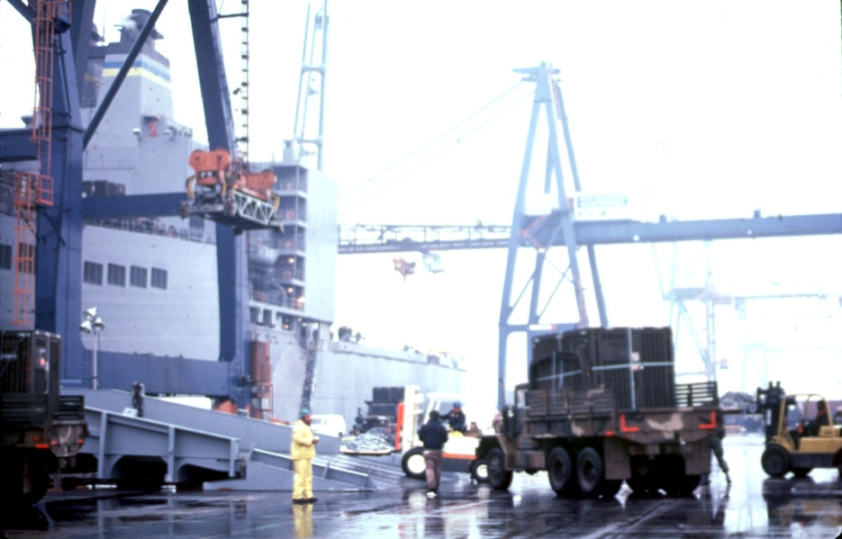
Roll On/Roll Off (Ro/Ro)

Slide 25
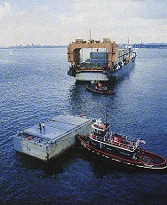
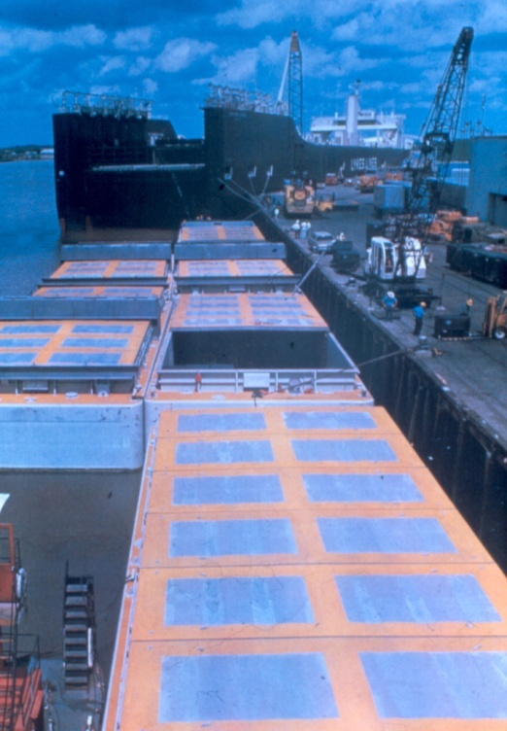
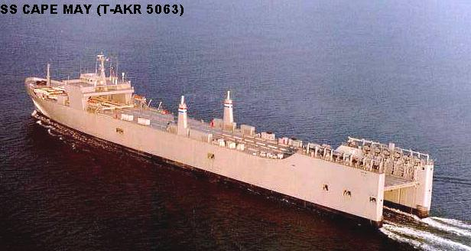
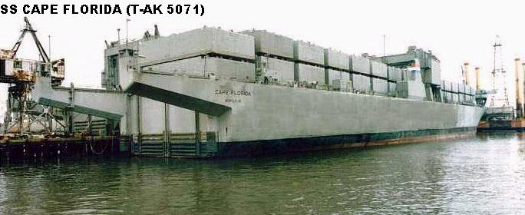
Lighter Aboard Ship (LASH)

Slide 26
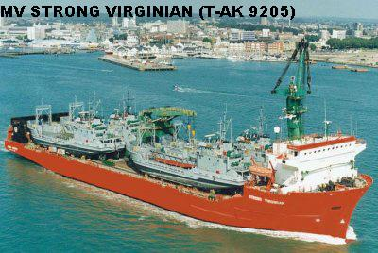
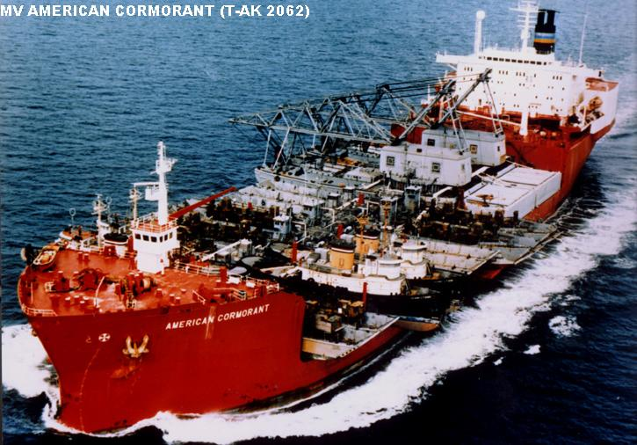
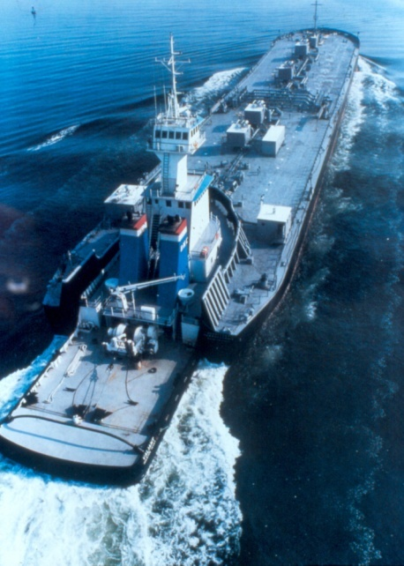
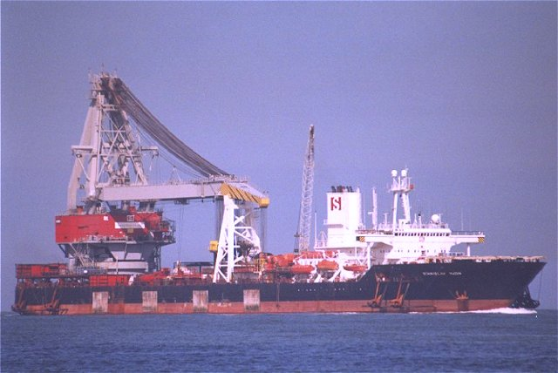
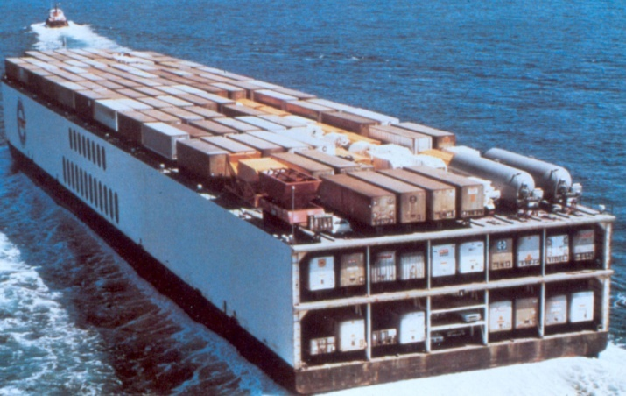
Float On /Float Off
Lift On/Lift Off (LO/LO)
Heavy Lifters
Sea Barge
Integrated Tow

Slide 27
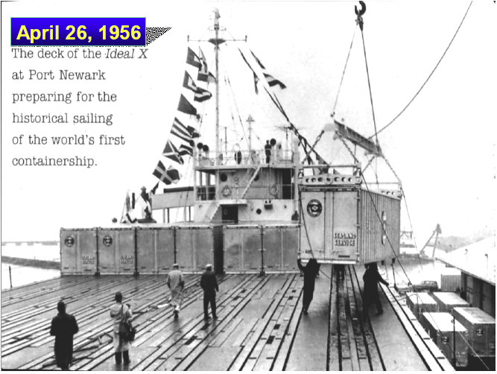

Slide 28
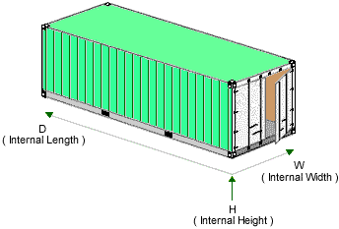
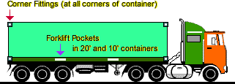
Length 20’
TEU
Width 8’
Height 8’ 6”
Twenty-Foot Equivalent Unit (TEU)

Slide 29
Foreign Flag Containership Characteristics
TEU | 600 | 1,600 | 2,500 | 3,000 | 4,800 | 6,000
DWT | 9,000 | 23,000 | 35,000 | 42,000 | 66,000 | 82,000
Length | 427 | 611 | 716 | 768 | 984 | 1,044
Beam | 68 | 89 | 100 | 105 | 122 | 140
Draft | 24 | 32 | 37 | 39 | 43 | 46
Immersion Rate (tpi) | 53 | 101 | 136 | 154 | 229 | 279
Hourly Cost at Sea | 485 | 842 | 1137 | 1327 | 1840 | 2298
Hourly Cost in Port | 383 | 552 | 697 | 799 | 928 | 1215
Note: All measurements in feet; tpi – tons per inch; cost in US $
Source: USACE Economic Guidance Memo 04-01 June 2004

Slide 30
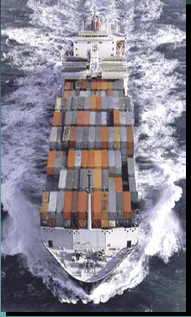
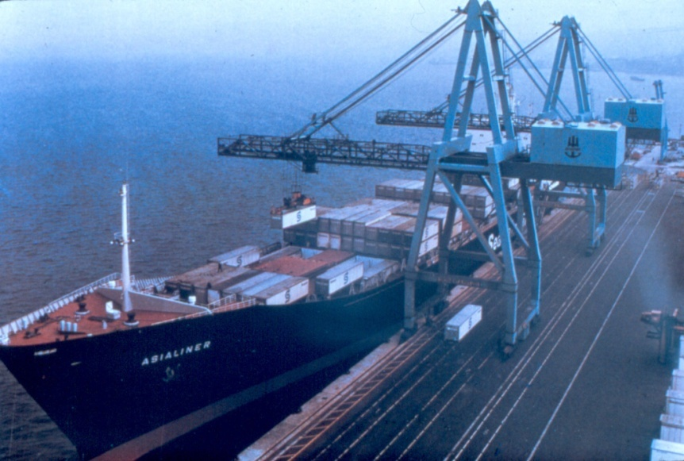
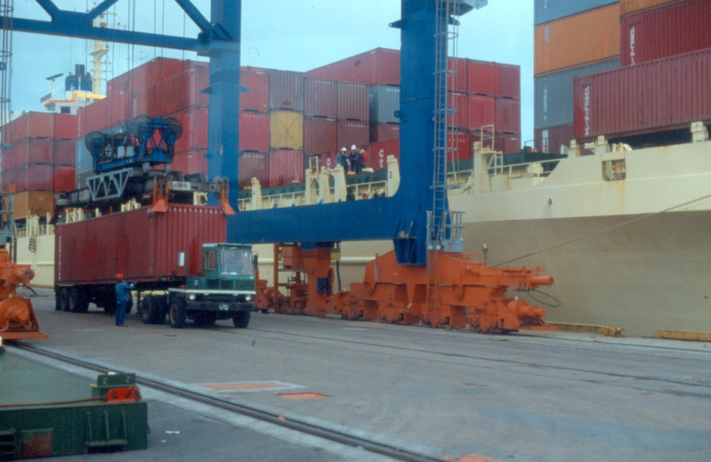
Containership

Slide 31
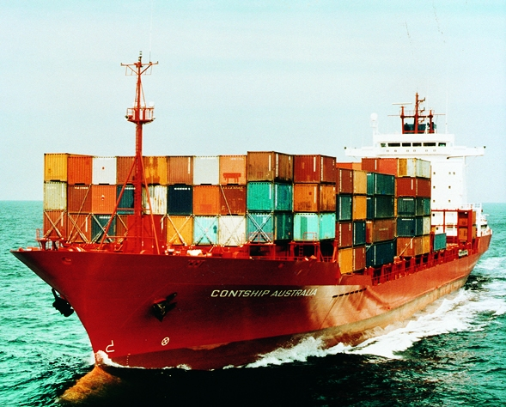
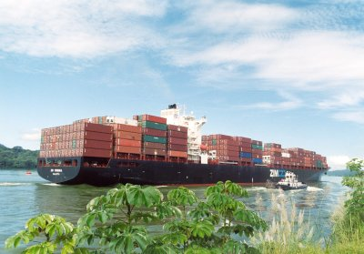
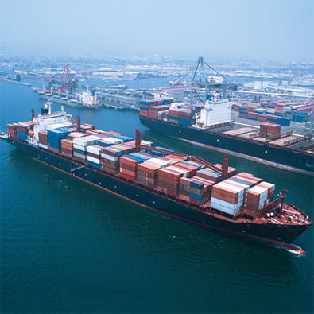
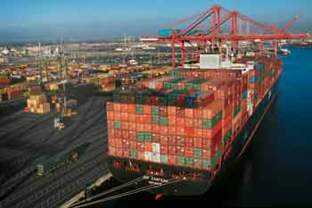
Containership

Slide 32
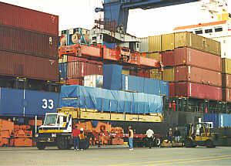
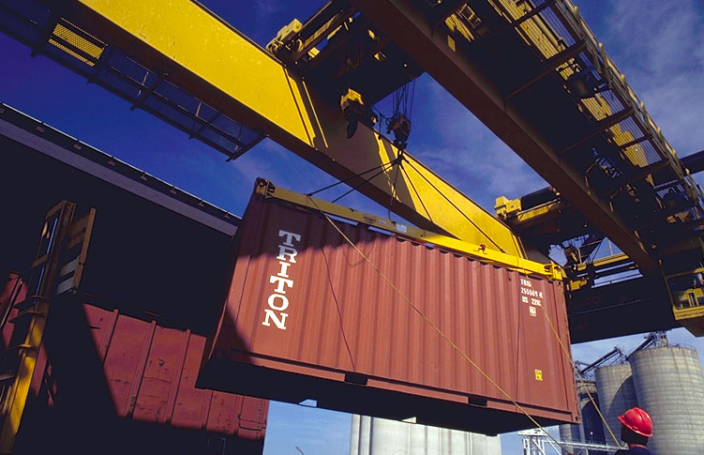
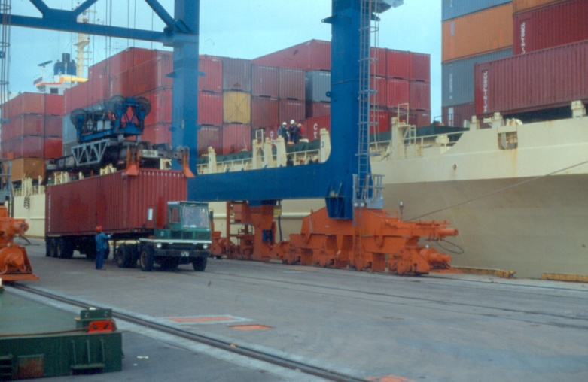


Loading Containers

Slide 33
Top 20 Container Ports by TEUs

Slide 34
Top 10 U.S. Container Ports, 2008
Twenty-Foot Equivalent Units (TEUs)
Rank | Port | TEUs (X 1,000)
1 | Los Angeles, CA | 5,521
2 | Long Beach, CA | 4,843
3 | New York, NY & NJ | 4,103
4 | Savannah, GA | 2,086
5 | Norfolk, VA | 1,645
6 | Oakland, CA | 1,548
7 | Tacoma, WA | 1,458
8 | Houston, TX | 1,371
9 | Charleston, SC | 1,307
10 | Seattle, WA | 1,224
Source: USACE Navigation Data Center

Slide 35




Bulk Carrier

Slide 36




Great Lakes - Coasters

Slide 37
Oil and Tanker Business
Oil Tankers carry about 40% of the world’s seaborne trade.
About 60% of the world’s crude oil is transported by seagoing tankers.
Crude is generally transported in larger vessels.
Tanker Size Groupings:
  Ultra Large Crude Carriers (ULCCs) > 320,000 DWT
  Very Large Crude Carriers (VLCCs) 200 – 320,000 DWT
  Suezmax (long to medium haul) 120 – 200,000 DWT
  Aframax (medium to short haul) 80 – 120,000 DWT
  Panamax (short haul) 55 - 70,000 DWT
  Handysize (smallest in world fleet) to as little as... 10,000 DWT

Slide 38
Foreign Flag Tanker Characteristics
DWT | 20,000 | 60,000 | 80,000 | 120,000 | 200,000 | 325,000
Length | 498 | 685 | 745 | 838 | 973 | 1,121
Beam | 79 | 113 | 124 | 141 | 167 | 195
Draft | 30 | 42 | 46 | 52 | 60 | 70
Immersion Rate (tpi) | 79 | 159 | 191 | 247 | 343 | 468
Hourly Cost at Sea | 647 | 840 | 930 | 1,080 | 1,389 | 1,782
Hourly Cost in Port | 512 | 653 | 721 | 822 | 1,039 | 1,292
Note: All measurements in feet; tpi – tons per inch; cost in US $
Source: USACE Economic Guidance Memo 06-01 June 2006

Slide 39




Oil Tanker

Slide 40

ULCC - Jahre Viking - 565,000 DWT) Length 1,504 ft; Beam 226 ft; Draft 81 ft

Slide 41



Cruise Ships

Slide 42

Duluth - Superior

Slide 43

Mobile Harbor

Slide 44



Louisiana Offshore Oil Port (LOOP)

Slide 45

Freeport Harbor

Slide 46



Long Beach

Slide 47


Port of Los Angeles

Slide 48


Port of Oakland

Slide 49
More Information on Dredging
http://education.usace.army.mil/navigation/dredging.html
USACE “Education Center” website (for students, teachers, librarians and other educators).

Slide 50
Some Trivia
State of _______ has deep draft port facilities on 4 Great Lakes.
__________ &_________ have ports along the Great Lakes and the Atlantic Coast.
The deep-water port farthest from the sea is ______________ (at miles 168 to 255 up the Mississippi River)
On the West Coast, ________&__________ operate the largest # of container cranes (80)
On the East Coast, ________&__________ operate the largest # of container cranes (50)

Slide 51
State of Michigan has deep draft port facilities on 4 Great Lakes.
Pennsylvania & New York have ports along the Great Lakes and the Atlantic Coast.
The deep-water port farthest from the sea is Baton Rouge (at miles 168 to 255 up the Mississippi River)
On the West Coast, Long Beach & Los Angeles operate the largest # of container cranes (80)
On the East Coast, New York & New Jersey operate the largest # of container cranes (50)

Slide 52
Issues in Economics of Container Ship Driven Channel Deepening

Slide 53
Background
The Corps experience in many Districtshas mostly been for bulk cargo.
  Bulk cargo ships generally have a simple itinerary, back and forth between only 2 ports
All economic analyses by the Corps of ports for containers have been done with homegrown spreadsheets, unique for each application, some of them developed by consultants.

Slide 54
What is Different about Container Traffic?
They have a scheduled itinerary calling at multiple ports
Port rotations dynamic
Vessels on rotation dynamic
Services at any port are complex with multiple rotations

Slide 55


Slide 56


Slide 57
Container Ship Operations & Loadings
Container ship cargo is diverse so that the draft a vessel needs to call at a port is variable from trip to trip
What a ship can carry depends on the number of container slots, design draft, the weight of the cargo, and other factors
  Some containers are empty meeting need to be repositioned to the exporting ports (see return route of previous slide)

Slide 58
Container Posers
Sailing drafts almost always significantly less than design drafts even in the deepest ports around the world
Carry TEU’s for multiple US ports except at the last US port of call
Carriers seem to add capacity rather than drafting deeper
  “Undulation” in sailing drafts
At deeper ports, larger vessels seem to have a larger share of total calls—statistical analysis suggestive but not definitive
At deeper ports, sailing draft distribution is deeper but not as much as expected.

Slide 59
Example Cost Efficiencies

Slide 64
Potential Impact of
Panama Canal Expansion
The expansion in the Panama Canal, scheduled to be completed in 2015
  Predicted to drastically change the size vessels on routes that use the canal
  These Post-Panamax ships are in service on other routes but cannot pass through the canal
  A relatively quick migration to these larger vessels is predicted once the canal opens

Slide 65




New Locks Dimensions
Actual Locks – Vessel Max: 4,800 TEUs
294.1m (965’)
33.5m (110’)
Draft
32.3m (106’)
12.04 m (39.5’)
304.8m (1000’)
366m (1200’)
12.8m (42’)
49m (160’)
55m (180’)
427m (1400’)
Draft
18.3m (60’)
15.2 m (50’)
New Locks – Vessel Max : 12,600 TEUs

Slide 66
Evolution of the Full Container Ship Fleet
Full Container Ship Fleet -
Vessel Size
Orderbook 2007-2012
Projected Fleet 2012
December 10, 2007
Number of
Number of
Number of
TEU
TEU Capacity
TEU Capacity
Vessels
Vessels
Vessels
Capacity
Feeders
100-499
438
136,079
11
2,607
449
138,686
Feedermax
500-999
785
574,847
155
130,864
940
705,711
Handy
1,000-1,999
1144
1,613,546
321
459,448
1465
2,072,994
Sub-Panamax
2,000-2,999
673
1,697,300
167
426,865
840
2,124,165
Panamax
3,000-4,000+
727
2,905,510
328
1,376,161
1055
4,281,671
Post-Panamax
3,700 - 13,300
557
3,734,910
474
4,215,918
1031
7,950,828
Total
4,324
10,662,192
1,456
6,611,863
5,780
17,274,055
% Post-Panamax
12.9%
35.0%
32.6%
63.8%
17.8%
46.0%
Average Vessel Size
% Panamax
18.3%
24.8%
Source: ACP, Shipping Intelligence Network, Clarkson Research, December 2007.

Slide 67
Economic Evaluation
The Corps has no standardized economic model to evaluate the benefits of navigation improvements to container ships.
Data issues daunting
Modeling subject to large uncertainties

Slide 68
Short Break
10 Minutes

